Slide 1
Chapter 2 – Software Processes
Lecture 1

Slide 2
Capability Maturity Model (CMM)
A bench-mark for measuring the maturity of an organization’s software process
CMM defines 5 levels of process maturity based on certain Key Process Areas (KPA)

Slide 3
CMM Levels
Level 5 – Optimizing (< 1%)
-- process change management
-- technology change management
-- defect prevention
Level 4 – Managed (< 5%)
-- software quality management
-- quantitative process management
Level 3 – Defined (< 10%)
-- peer reviews
-- intergroup coordination
-- software product engineering
-- integrated software management
-- training program
-- organization process definition
-- organization process focus
Level 2 – Repeatable (~ 15%)
-- software configuration management
-- software quality assurance
-- software project tracking and oversight
-- software project planning
-- requirements management
Level 1 – Initial (~ 70%)

Slide 4
The software process
A structured set of activities required to develop a software system.
Many different software processes but all involve:
Specification – defining what the system should do;
Design and implementation – defining the organization of the system and implementing the system;
Validation – checking that it does what the customer wants;
Evolution – changing the system in response to changing customer needs.
A software process model is an abstract representation of a process. It presents a description of a process from some particular perspective.

Slide 5
Software process descriptions
When we describe and discuss processes, we usually talk about the activities in these processes such as specifying a data model, designing a user interface, etc. and the ordering of these activities.
Process descriptions may also include:
Products, which are the outcomes of a process activity;
Roles, which reflect the responsibilities of the people involved in the process;
Pre- and post-conditions, which are statements that are true before and after a process activity has been enacted or a product produced.

Slide 6
Plan-driven and agile processes
Plan-driven processes are processes where all of the process activities are planned in advance and progress is measured against this plan.
In agile processes, planning is incremental and it is easier to change the process to reflect changing customer requirements.
In practice, most practical processes include elements of both plan-driven and agile approaches.
There are no right or wrong software processes.

Slide 7
Software process models
The waterfall model
Plan-driven model. Separate and distinct phases of specification and development.
Incremental development
Specification, development and validation are interleaved. May be plan-driven or agile.
Reuse-oriented software engineering
The system is assembled from existing components. May be plan-driven or agile.
In practice, most large systems are developed using a process that incorporates elements from all of these models.

Slide 8
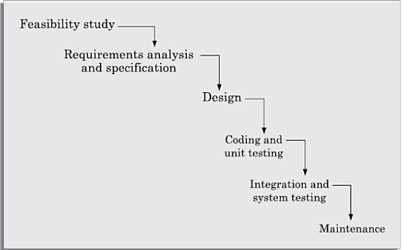
The waterfall model

Slide 9
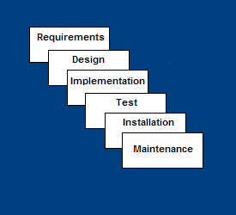
Waterfall Model
Requirements – defines needed information, function, behavior, performance and interfaces.
Design – data structures, software architecture, interface representations, algorithmic details.
Implementation – source code, database, user documentation, testing.

Slide 10
Waterfall Strengths
Easy to understand, easy to use
Provides structure to inexperienced staff
Milestones are well understood
Sets requirements stability
Good for management control (plan, staff, track)
Works well when quality is more important than cost or schedule

Slide 11
Waterfall Deficiencies
All requirements must be known upfront
Deliverables created for each phase are considered frozen – inhibits flexibility
Can give a false impression of progress
Does not reflect problem-solving nature of software development – iterations of phases
Integration is one big bang at the end
Little opportunity for customer to preview the system (until it may be too late)

Slide 12
When to use the Waterfall Model
Requirements are very well known
Product definition is stable
Technology is understood
New version of an existing product
Porting an existing product to a new platform.

Slide 13
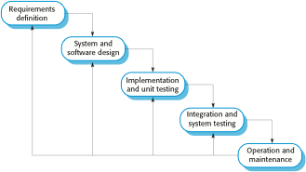
The Iterative waterfall model
Feasibility study

Slide 14
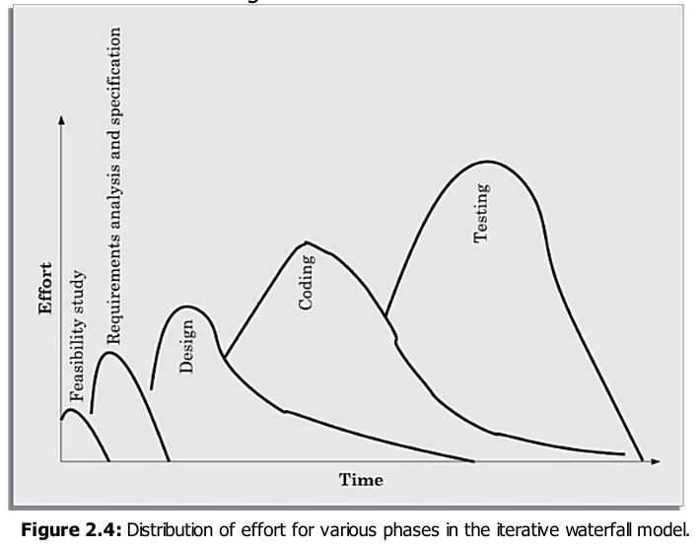
The Iterative waterfall model

Slide 15
Waterfall model phases
There are separate identified phases in the waterfall model:
Requirements analysis and definition
System and software design
Implementation and unit testing
Integration and system testing
Operation and maintenance
The main drawback of the waterfall model is the difficulty of accommodating change after the process is underway. In principle, a phase has to be complete before moving onto the next phase.

Slide 16
Waterfall model problems
Inflexible partitioning of the project into distinct stages makes it difficult to respond to changing customer requirements.
Therefore, this model is only appropriate when the requirements are well-understood and changes will be fairly limited during the design process.
Few business systems have stable requirements.
The waterfall model is mostly used for large systems engineering projects where a system is developed at several sites.
In those circumstances, the plan-driven nature of the waterfall model helps coordinate the work.

Slide 17
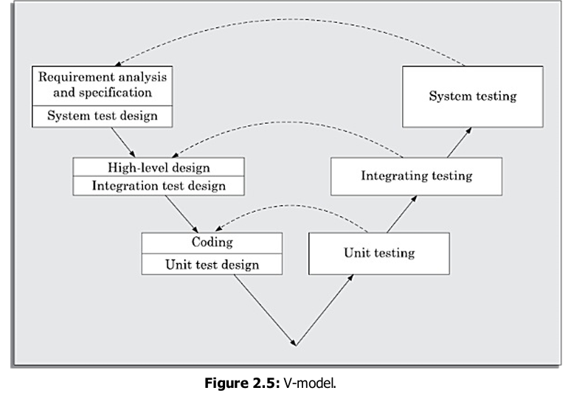
The V model

Slide 18
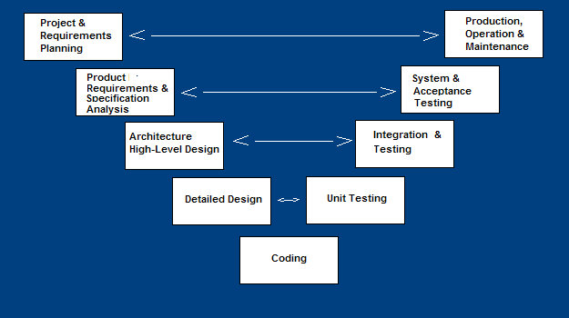
V-Shaped SDLC Model
A variant of the Waterfall that emphasizes the verification and validation of the product.
Testing of the product is planned in parallel with a corresponding phase of development

Slide 19
V-Shaped Steps
Project and Requirements Planning – allocate resources
Product Requirements and Specification Analysis – complete specification of the software system
Architecture or High-Level Design – defines how software functions fulfill the design
Detailed Design – develop algorithms for each architectural component
Production, operation and maintenance – provide for enhancement and corrections
System and acceptance testing – check the entire software system in its environment
Integration and Testing – check that modules interconnect correctly
Unit testing – check that each module acts as expected
Coding – transform algorithms into software

Slide 20
V-Shaped Strengths
Emphasize planning for verification and validation of the product in early stages of product development
Each deliverable must be testable
Project management can track progress by milestones
Easy to use

Slide 21
V-Shaped Weaknesses
Does not easily handle concurrent events
Does not handle iterations or phases
Does not easily handle dynamic changes in requirements
Does not contain risk analysis activities

Slide 22
When to use the V-Shaped Model
Excellent choice for systems requiring high reliability – hospital patient control applications
All requirements are known up-front
When it can be modified to handle changing requirements beyond analysis phase
Solution and technology are known

Slide 23
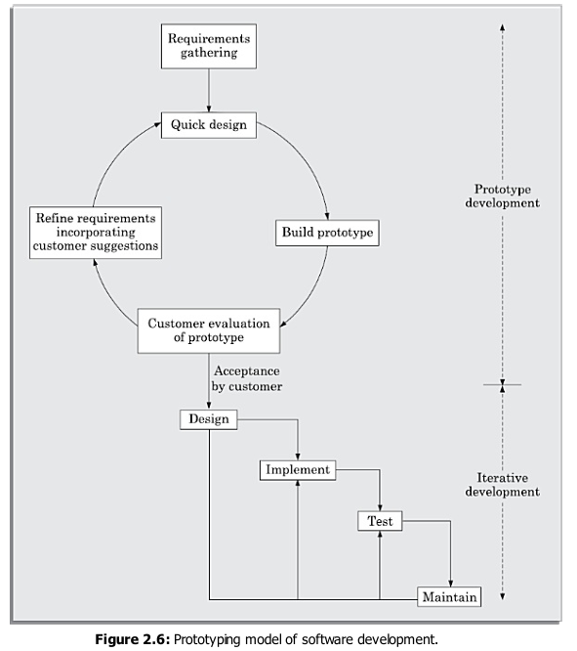
The Prototype model

Slide 24
Structured Evolutionary Prototyping Model
Developers build a prototype during the requirements phase
Prototype is evaluated by end users
Users give corrective feedback
Developers further refine the prototype
When the user is satisfied, the prototype code is brought up to the standards needed for a final product.

Slide 25
Structured Evolutionary Prototyping Steps
A preliminary project plan is developed
A partial high-level paper model is created
The model is source for a partial requirements specification
A prototype is built with basic and critical attributes
The designer builds
the database
user interface
algorithmic functions
The designer demonstrates the prototype; the user evaluates for problems and suggests improvements.
This loop continues until the user is satisfied

Slide 26
Structured Evolutionary Prototyping Strengths
Customers can “see” the system requirements as they are being gathered
Developers learn from customers
A more accurate end product
Unexpected requirements accommodated
Allows for flexible design and development
Steady, visible signs of progress produced
Interaction with the prototype stimulates awareness of additional needed functionality

Slide 27
Structured Evolutionary Prototyping Weaknesses
Tendency to abandon structured program development for “code-and-fix” development
Bad reputation for “quick-and-dirty” methods
Overall maintainability may be overlooked
The customer may want the prototype delivered.
Process may continue forever (scope creep)

Slide 28
When to use Structured Evolutionary Prototyping
Requirements are unstable or have to be clarified
As the requirements clarification stage of a waterfall model
Develop user interfaces
Short-lived demonstrations
New, original development
With the analysis and design portions of object-oriented development.

Slide 29
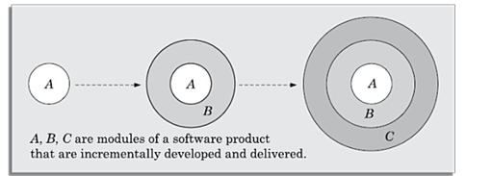
The Incremental development model

Slide 30
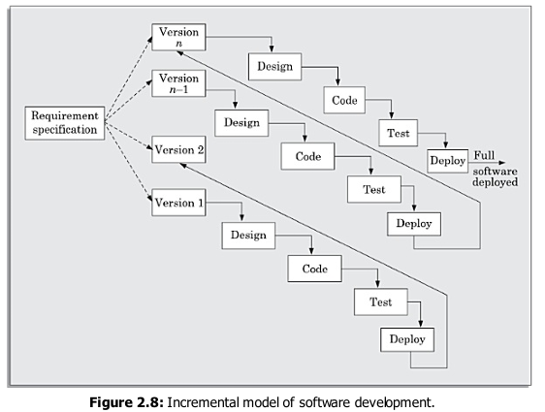
The Incremental developement model

Slide 31
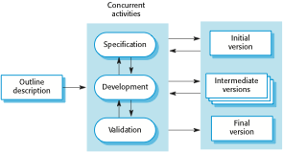
Incremental development

Slide 32
Incremental development benefits
The cost of accommodating changing customer requirements is reduced.
The amount of analysis and documentation that has to be redone is much less than is required with the waterfall model.
It is easier to get customer feedback on the development work that has been done.
Customers can comment on demonstrations of the software and see how much has been implemented.
More rapid delivery and deployment of useful software to the customer is possible.
Customers are able to use and gain value from the software earlier than is possible with a waterfall process.

Slide 33
Incremental development problems
The process is not visible.
Managers need regular deliverables to measure progress. If systems are developed quickly, it is not cost-effective to produce documents that reflect every version of the system.
System structure tends to degrade as new increments are added.
Unless time and money is spent on refactoring to improve the software, regular change tends to corrupt its structure. Incorporating further software changes becomes increasingly difficult and costly.

Slide 34
Incremental Model Strengths
Develop high-risk or major functions first
Each release delivers an operational product
Customer can respond to each build
Uses “divide and conquer” breakdown of tasks
Lowers initial delivery cost
Initial product delivery is faster
Customers get important functionality early
Risk of changing requirements is reduced

Slide 35
Incremental Model Weaknesses
Requires good planning and design
Requires early definition of a complete and fully functional system to allow for the definition of increments
Well-defined module interfaces are required (some will be developed long before others)
Total cost of the complete system is not lower

Slide 36
When to use the Incremental Model
Risk, funding, schedule, program complexity, or need for early realization of benefits.
Most of the requirements are known up-front but are expected to evolve over time
A need to get basic functionality to the market early
On projects which have lengthy development schedules
On a project with new technology

Slide 37
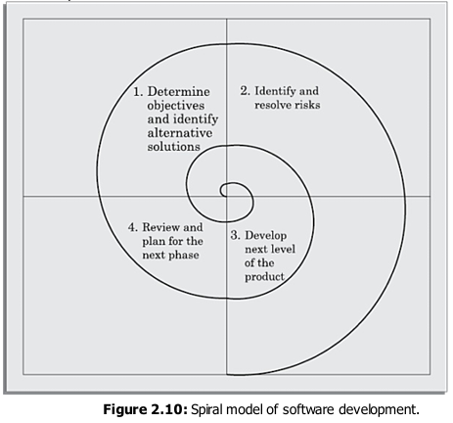
Boehm’s spiral model of the software process

Slide 38
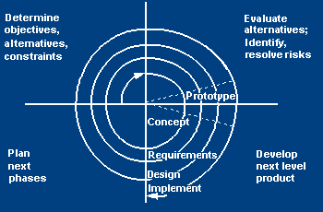
Spiral SDLC Model
Adds risk analysis, and 4gl RAD prototyping to the waterfall model
Each cycle involves the same sequence of steps as the waterfall process model

Slide 39
Spiral Quadrant Determine objectives, alternatives and constraints
Objectives: functionality, performance, hardware/software interface, critical success factors, etc.
Alternatives: build, reuse, buy, sub-contract, etc.
Constraints: cost, schedule, interface, etc.

Slide 40
Spiral Quadrant Evaluate alternatives, identify and resolve risks
Study alternatives relative to objectives and constraints
Identify risks (lack of experience, new technology, tight schedules, poor process, etc.
Resolve risks (evaluate if money could be lost by continuing system development

Slide 41
Spiral Quadrant Develop next-level product
Typical activites:
Create a design
Review design
Develop code
Inspect code
Test product

Slide 42
Spiral Quadrant Plan next phase
Typical activities
Develop project plan
Develop configuration management plan
Develop a test plan
Develop an installation plan

Slide 43
Spiral Model Strengths
Provides early indication of insurmountable risks, without much cost
Users see the system early because of rapid prototyping tools
Critical high-risk functions are developed first
The design does not have to be perfect
Users can be closely tied to all lifecycle steps
Early and frequent feedback from users
Cumulative costs assessed frequently

Slide 44
Spiral Model Weaknesses
Time spent for evaluating risks too large for small or low-risk projects
Time spent planning, resetting objectives, doing risk analysis and prototyping may be excessive
The model is complex
Risk assessment expertise is required
Spiral may continue indefinitely
Developers must be reassigned during non-development phase activities
May be hard to define objective, verifiable milestones that indicate readiness to proceed through the next iteration

Slide 45
When to use Spiral Model
When creation of a prototype is appropriate
When costs and risk evaluation is important
For medium to high-risk projects
Long-term project commitment unwise because of potential changes to economic priorities
Users are unsure of their needs
Requirements are complex
New product line
Significant changes are expected (research and exploration)

Slide 46
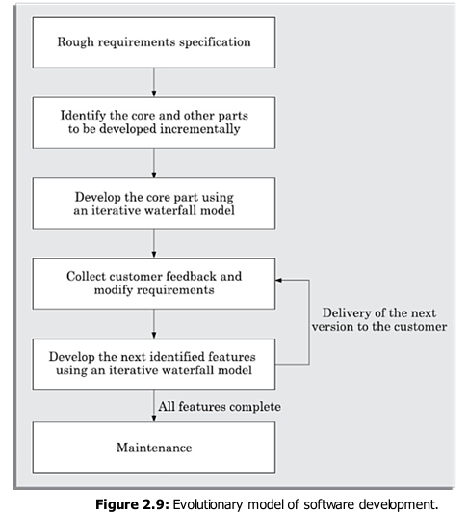
The Evolutionary Model

